Slide 1
20241102 F22 RUN S01 STEP.7 MFC-01 ALARM issue

Slide 2
Discipline 1. 選定團隊 Form the Team
S210
S220

Slide 3
Discipline 2.描述問題及現況掌握Describe the Problem
(WHO detected the problem? WHAT is wrong? State the problem in terms of object and defect. WHERE the problem was first detected, describe location of the detection, lot #, WHEN and HOW it was detected)
What | 2024/11/02 F22 RUN S01 STEP.7 MFC-01 ALARM issue 產品厚度(Å) slot-1 C1/C4/C6: 541.5/533.1/526.5 OOS(SPEC:400+/-40)
Where | F22
When | 2024/11/2
Extent | Impact 6 lots/150pcs
上貨時間 | 機台 | 程式 | LOC | Lot | Product | Route | Oper | Qty
2024/11/2 11:13 | F22 | F22S01 | 1 | 24450510 | YDV01W D | U041FI | 1302 | 25
2024/11/2 11:13 | F22 | F22S01 | 2 | 24450160 | YDV01W D | U041FI | 1302 | 25
2024/11/2 11:13 | F22 | F22S01 | 3 | 24443470 | Y7S02W B | T046DI | 1302 | 25
2024/11/2 11:13 | F22 | F22S01 | 4 | 24450350 | YDV01W D | U041FI | 1302 | 25
2024/11/2 11:13 | F22 | F22S01 | 5 | 24450500 | YDV01W D | U041FI | 1302 | 25
2024/11/2 11:13 | F22 | F22S01 | 6 | 24450320 | YDV01W D | U041FI | 1302 | 25

Slide 4
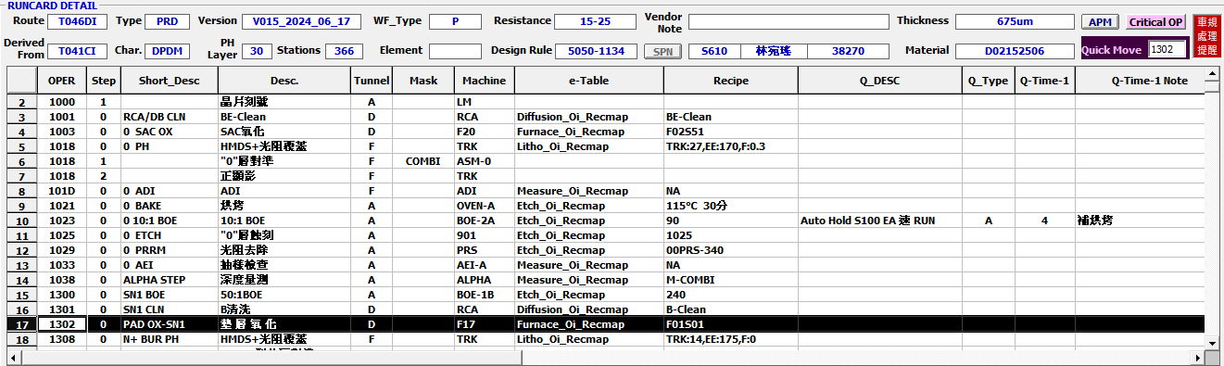
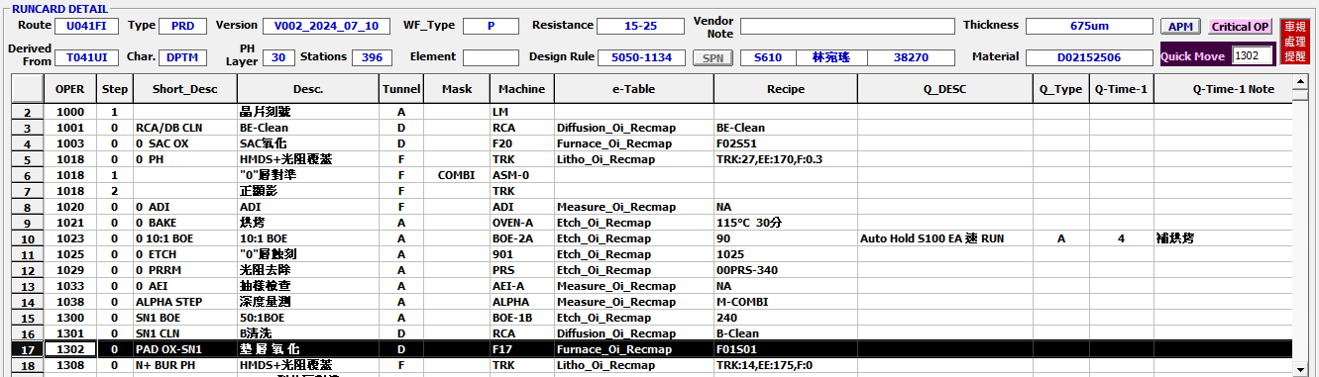
Runcard

Slide 5
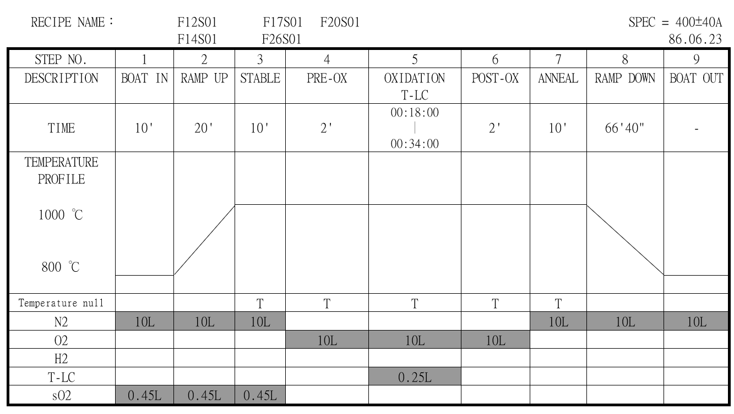
Discipline 2.描述問題及現況掌握Describe the Problem
(WHO detected the problem? WHAT is wrong? State the problem in terms of object and defect. WHERE the problem was first detected, describe location of the detection, lot #, WHEN and HOW it was detected)
異常點
Step.7未通N2，造成殘存O2與Si繼續反應。

Slide 6
Discipline 2.描述問題及現況掌握Describe the Problem
(WHO detected the problem? WHAT is wrong? State the problem in terms of object and defect. WHERE the problem was first detected, describe location of the detection, lot #, WHEN and HOW it was detected)
RMS check : step.7 Anneal 步驟alarm,溫度皆正常。
設定溫度
實際溫度

Slide 7
Discipline 2.描述問題及現況掌握Describe the Problem
(WHO detected the problem? WHAT is wrong? State the problem in terms of object and defect. WHERE the problem was first detected, describe location of the detection, lot #, WHEN and HOW it was detected)
RMS check gas flow :流量皆正常
設定流量
實際流量
N2
O2
T-LC
N2
O2
T-LC
Step.7 約十分鐘未通N2
Step.8 約十分鐘未通N2

Slide 8
產品確認 : 量測厚度C1/C4/C6皆OOS
Discipline 3.執行及驗證暫時防堵對策 Contain the Problem
(Define and implement containment actions to isolate the effect of problem from any internal/external customer until corrective action is implemented)
上貨時間 | 機台 | 程式 | LOC | Lot | Product | Route | Oper | Qty | U | C | D | L | R | AVERAGE | SPEC
2024/11/2 11:13 | F22 | F22S01 | 1 | 24450510 | YDV01W D | U041FI | 1302 | 25 | 537.3 | 541.45 | 545.51 | 538.34 | 545.02 | 541.524 | 400+/-40
2024/11/2 11:13 | F22 | F22S01 | 2 | 24450160 | YDV01W D | U041FI | 1302 | 25
2024/11/2 11:13 | F22 | F22S01 | 3 | 24443470 | Y7S02W B | T046DI | 1302 | 25
2024/11/2 11:13 | F22 | F22S01 | 4 | 24450350 | YDV01W D | U041FI | 1302 | 25 | 527.48 | 533.32 | 537.23 | 534.08 | 533.63 | 533.148
2024/11/2 11:13 | F22 | F22S01 | 5 | 24450500 | YDV01W D | U041FI | 1302 | 25
2024/11/2 11:13 | F22 | F22S01 | 6 | 24450320 | YDV01W D | U041FI | 1302 | 25 | 517.76 | 526.77 | 533.07 | 525.29 | 529.79 | 526.536
Action: (1)6批產品做PAD RWK。
(2)PAD 前加量C1厚度，確認蝕刻乾淨再重RUN 1302站。

Slide 9
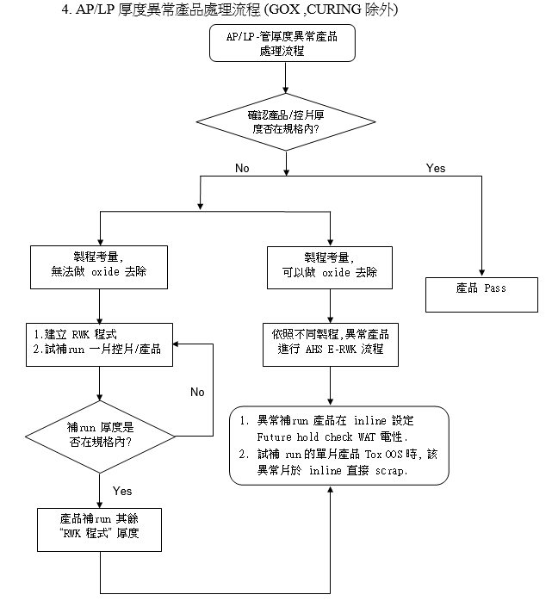
OCAP

Slide 10
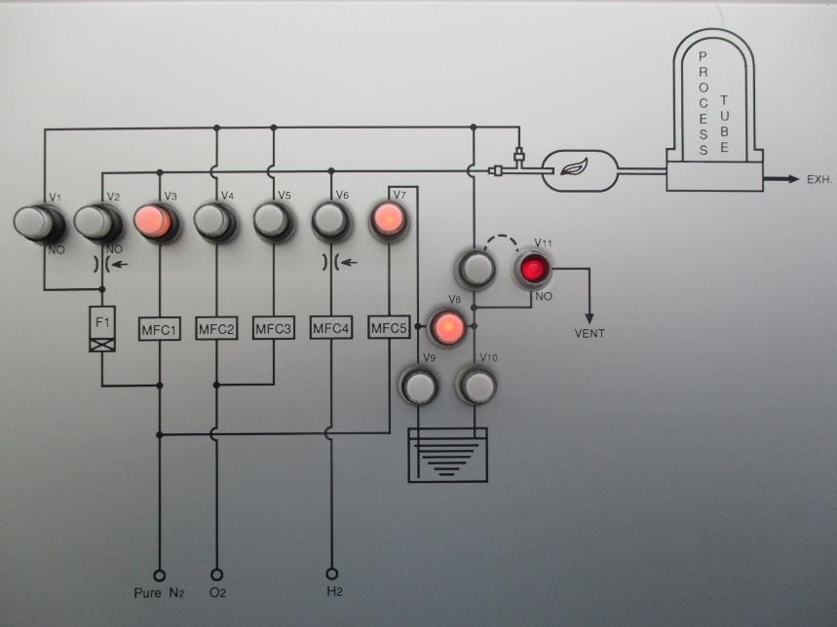
Discipline 3.執行及驗證暫時防堵對策 Contain the Problem
(Define and implement containment actions to isolate the effect of problem from any internal/external customer until corrective action is implemented)
EQ check：
1. Check MFC-01 後方 V3 valve 電磁閥無給氣，故 MFC-01 (N2) 無流量

Slide 11
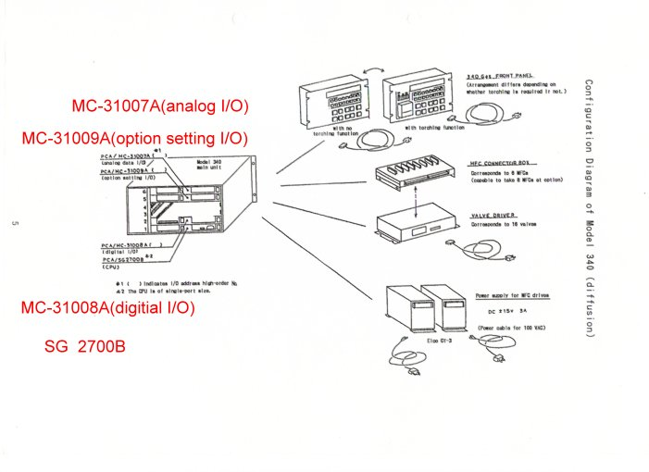
2. 量測 V3 電磁閥無 DC+24V，其餘電磁閥 DC+24V normal
3. 更換 M340 MC31008-1 PCB，check V3 電磁閥有 DC+24V ok
4. 修改 recipe 切換 MFC-01 10L → 0L *10次，MFC-01 flow 皆正常
5. Test run S02，TOX avg=248/249/250 ok，release
MC-31008-01 PCB
Issue parts
MC-31007A(analog I/O)：類比訊號介面，用於如MFC 控制。
MC-31008A(digital I/O)：數位訊號介面，用於如VALVE、FRONT PANEL控制。
MC-31009A(option set I/O)：操作設定介面，亦與APC DRIVER控制有關。
SG 2700B(cpu)：如電腦CPU一樣為M340大腦，用以訊號運算處理。將M340各項訊號資料傳至3100(3200)，作為與3100(3200)面板的訊號傳輸橋樑。

Slide 12
Summary
2024/11/02 F22 RUN S01 STEP.7 MFC-01 ALARM issue
Step.7~Step.8約有20分鐘未通N2，造成產品厚度偏厚OOS。
產品確認 :
Action: (1)6批產品做PAD RWK。
(2)PAD 前加量C1厚度，確認蝕刻乾淨再重RUN 1302站。
機台:
Check MFC-01 後 V3 電磁閥 no power，故 MFC-01 no flow
更換 M340 內 MC-31008-1 PCB 後 ok
Test run S02，TOX avg=248/249/250 ok，release
上貨時間 | 機台 | 程式 | LOC | Lot | Product | Route | Oper | Qty | U | C | D | L | R | AVERAGE | SPEC
2024/11/2 11:13 | F22 | F22S01 | 1 | 24450510 | YDV01W D | U041FI | 1302 | 25 | 537.3 | 541.45 | 545.51 | 538.34 | 545.02 | 541.524 | 400+/-40
2024/11/2 11:13 | F22 | F22S01 | 2 | 24450160 | YDV01W D | U041FI | 1302 | 25
2024/11/2 11:13 | F22 | F22S01 | 3 | 24443470 | Y7S02W B | T046DI | 1302 | 25
2024/11/2 11:13 | F22 | F22S01 | 4 | 24450350 | YDV01W D | U041FI | 1302 | 25 | 527.48 | 533.32 | 537.23 | 534.08 | 533.63 | 533.148
2024/11/2 11:13 | F22 | F22S01 | 5 | 24450500 | YDV01W D | U041FI | 1302 | 25
2024/11/2 11:13 | F22 | F22S01 | 6 | 24450320 | YDV01W D | U041FI | 1302 | 25 | 517.76 | 526.77 | 533.07 | 525.29 | 529.79 | 526.536

Slide 13
Discipline 3.執行及驗證暫時防堵對策 Contain the Problem
(Define and implement containment actions to isolate the effect of problem from any internal/external customer until corrective action is implemented)
3.1 異常產品 (Defect Lots)
項目 Item | 處理方式 Action | 負責人員 Resp | 預定完成日 Due | 實際完成日 Imp. | 處理結果 Verification
3.2 波及產品 (Impact Lots)
項目 Item | 處理方式 Action | 負責人員 Resp | 預定完成日 Due | 實際完成日 Imp. | 處理結果 Verification

Slide 14
Discipline 3.執行及驗證暫時防堵對策 Contain the Problem
(Define and implement containment actions to isolate the effect of problem from any internal/external customer until corrective action is implemented)
3.3 波及設備 (Impact Machine)
項目 Item | 處理方式 Action | 負責人員 Resp | 預定完成日 Due | 實際完成日 Imp. | 處理結果 Verification
N.A | N.A | N.A | N.A | N.A | N.A
3.4 波及製程 (Impact Route) : 是(YES)/否(No)
項目 Item | 處理方式 Action | 負責人員 Resp | 預定完成日 Due | 實際完成日 Imp. | 處理結果 Verification
N.A | N.A | N.A | N.A | N.A | N.A
3.5 產品召回選項，是否需進行客戶端波及產品的召回?是(YES)/否(No)
Customer | Product No. | Lot number / Wafer number | Approx. Quantity
N.A | N.A | N.A | N.A

Slide 15
Discipline 4.定義及驗證真因 (Identify the Root Cause)
(Identify all potential causes which could explain why the problem occurred)
4.1 Non-conformance root cause (defect nature / technical root cause):
c) 真因驗證 (Root Cause Verification)

Slide 16
Discipline 4.定義及驗證真因 (Identify the Root Cause)
(Identify all potential causes which could explain why the problem occurred)
4.1 Non-conformance root cause (defect nature / technical root cause):
d) 5-Why analysis
b) Conclusion :

Slide 17
Discipline 4.定義及驗證真因 (Identify the Root Cause)
(Identify all potential causes which could explain why the problem occurred)
4.2 Non-detection / escape root cause (Provide reason to why the current system failed to detect)
a) 5-why:
b) Conclusion

Slide 18
Discipline 5.擬定及驗證永久改善對策Choose and verify permanent corrective action (列出各項執行之對策並檢核其對策有效性)
5.1 What was the chosen corrective action to correct the root cause? (Add photo or diagram where applicable.)
Short term :
Long term:

Slide 19
Discipline 5.擬定及驗證永久改善對策Choose and verify permanent corrective action (列出各項執行之對策並檢核其對策有效性)
5.1 What was the chosen corrective action to correct the root cause? (Add photo or diagram where applicable.)

Slide 20
Discipline 5.擬定及驗證永久改善對策Choose and verify permanent corrective action (列出各項執行之對策並檢核其對策有效性)
5.2 Verification of actions effectiveness

Slide 21
Discipline 5.擬定及驗證永久改善對策Choose and verify permanent corrective action (列出各項執行之對策並檢核其對策有效性)
5.2 Verification of actions effectiveness

Slide 22
Discipline 6.實施認永久改善對策Corrective Actions Implementation
6.1 For non-conformance root cause (defect nature / technical root cause):
6.2 For non-detection / escape root cause

Slide 23
Discipline 7.避免再發Prevent Recurrence (Modify System / Document)
7.1 Systemic Actions:

Slide 24
Discipline 7.避免再發Prevent Recurrence (Modify System / Document)

Slide 25
Discipline 7.避免再發Prevent Recurrence (Modify System / Document)
7.2 Corrective Actions Fan-out: (水平展開):

Slide 26
Discipline 8. Congratulate the Team
Thanks for every member helped in this case.
Reviewed and Approved by:

